Slide 1
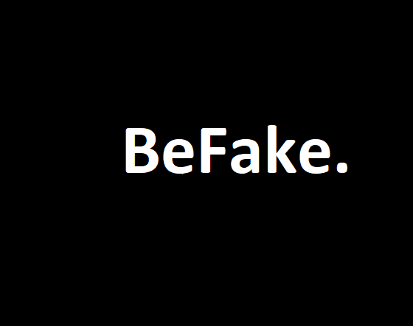
CMSI 2022: Mobile Application Development
Clement Canel, Alex Gordon, Elijah Senior, & Dawit Solomon
Assignment 0503

Slide 2
Team & Roles
Clement Canel → Technical Writer
Alex Gordon →Project Manager
Elijah Senior → Head Developer
Dawit Solomon → Developer

Slide 3
Needs & Audience
Needs:
Interaction with friends
Familiarity with sports
Quick thinking and reaction time
Audience
Middle school to high school students
University students
Young adults starting new jobs or the next chapter of their life
People in their low to mid 30's starting new families and new chapters of their life

Slide 4
Idea Brainstormed For Chosen Needs
BeFake: A game where users compete with friends to see who is the "fakest", with incentives and rewards for the most authentic posts, local and global leaderboards, and a limit of one post per day.
Sports game: A trivia game that allows users to select a specific sport and difficulty level, and offers immediate feedback on correct or incorrect answers, with the option to compete against friends.
Act quick game: A game that challenges users to react quickly to split-second decisions and allows for improvement over time, with memory tests and a global leaderboard to check progress.

Slide 5
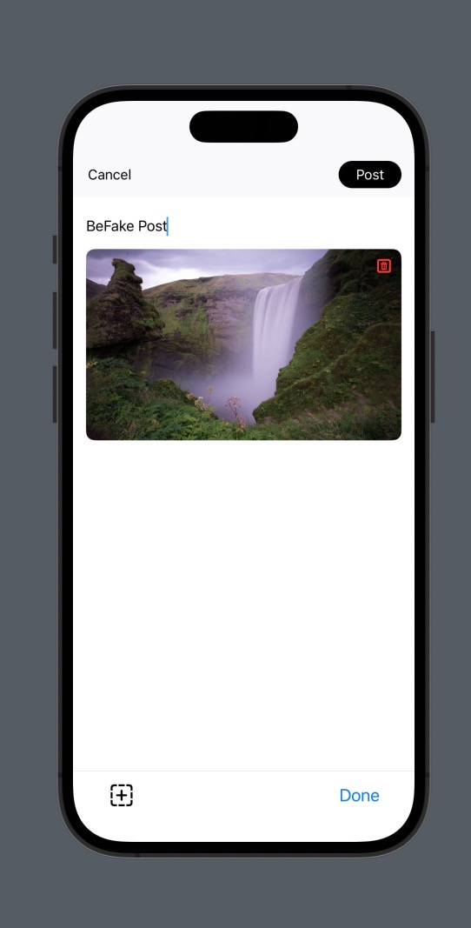
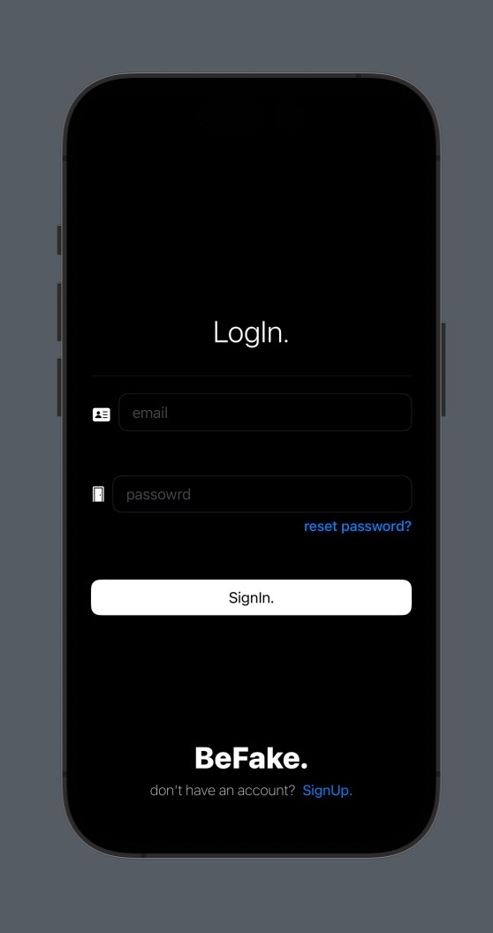
Screenshots of App

Slide 6
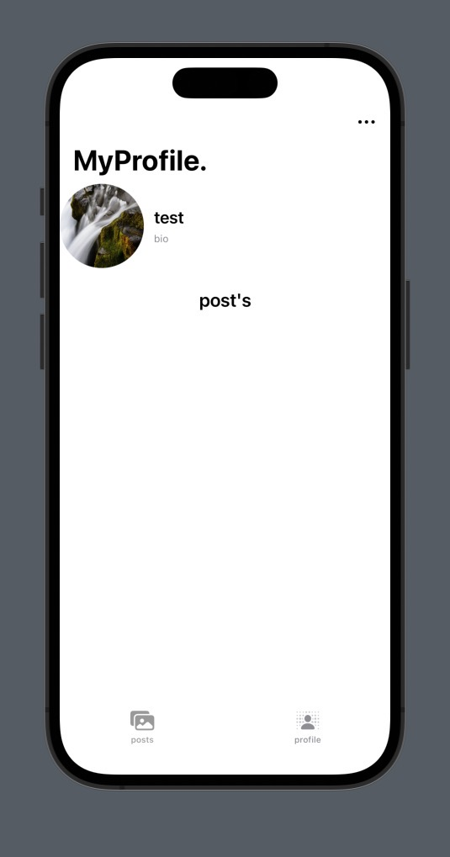
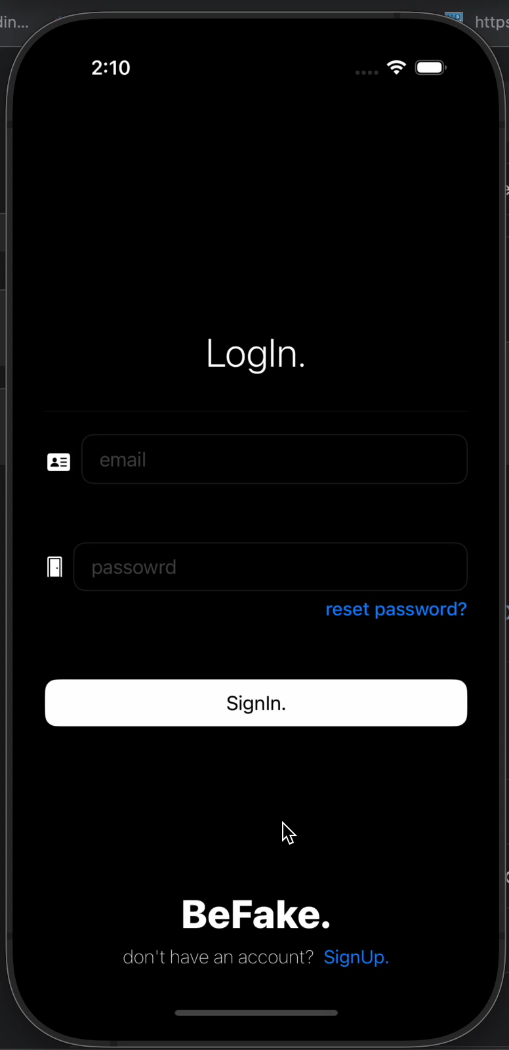
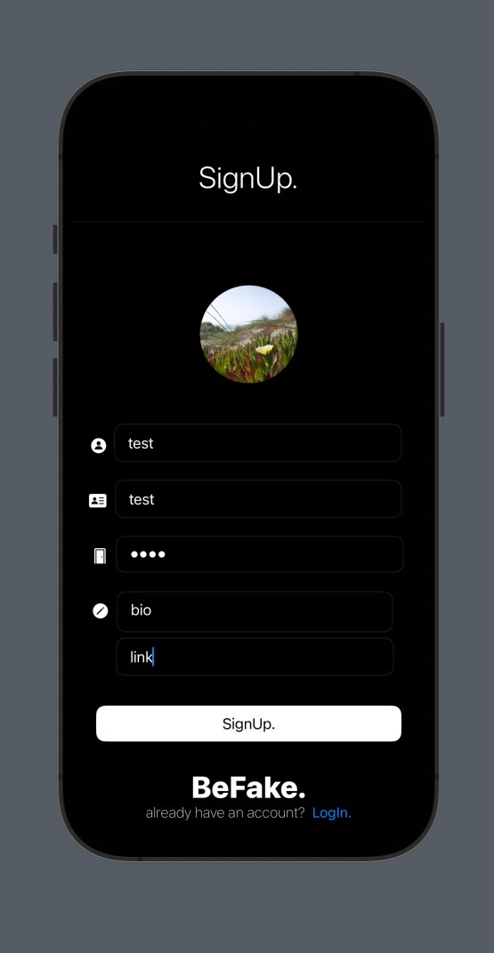

Slide 7


API, Database
Viber REST API | Viber Developers Hub

Slide 8
Challenges
Integrating the API
User Engagement: The app's success depends on user engagement. It may be challenging to design a user interface that is engaging enough to retain users' interest and encourage them to continue using the app regularly.

Slide 9
Credits
Clement Canel
Alex Gordon
Elijah Senior
Dawit Solomon
Professor Dondi

